Slide 1
What is CSS?
Cascading Style Sheets

Slide 2
CSS
CSS is meant for the presentation of web page’s content, or rather, how a web page is meant to look.
We can use CSS to modify any HTML tag, to deliver a branded experience in graphical browser.
Users accessing the pages with more primitive devices will still be able to understand and use the site.

Slide 3
The Style Rule
CSS allows the author to specify formatting & presentation of HTML elements using CSS Style Rules.
A CSS Style Rule looks like this
h1 {
font-size: 24px;
font-family: Helvetica; Values
color: blue;
}
Selector are used in CSS to style a specific HTML element, or multiple HTML elements
Selector

Slide 4
Inheritance of Styles
Parent/child relationship on CSS
<h1> Hey, <em> look </em> at the screen </h1>
The h1 is the parent element of the em. Therefore, if we add the style color:blue; to the h1 then the em will inherit that style and also be color: blue;
However, there are exceptions. If you gave the h1 a border, then it’s child elements would not inherit the border, because that would look awful if every child element had a border just because you wanted it’s parent to have one

Slide 5
Measurements in CSS
Pixels, Percentages, Ems & Rems!
In CSS, you use measurements a lot. Margin, padding, font size, width, height, etc.
All use measurements to determine the size of a specific value.
h1 {
font-size: 2.4rem;
width: 50%;
padding: 2em;
margin: 10px;
}

Slide 6
Measurements in CSS
Here are the most common measurements used in CSS:
Unit Description
px pixels
% percent
em Relative to the font size of the parent element. If the parent has a font size of 14px, then 1em = 14px
rem Relative to the font size of the root element (html element). If the html element is 18px, then
1rem = 18px

Slide 7
The CSS Box Model
Margin
Width
Padding
Content Area
Border

Slide 8
Margin
Margins live outside the box. In the example, the margin has a dashed line around it just to show the area it resides in. In the browser, margins are invisible.
Top & bottom margins overlap on adjacent elements. If you have an h3 followed by an h4, and you’ve defined the h3 to have margin-bottom: 30px and the h4 to margin-top: 10px you might think this adds up to 40px but it doesn’t. The two margins overlap, and the larger of the two margins are used, therefore the margin between these elements would be 30px.

Slide 9
Using Margin & Padding
To add margin & padding in CSS, all we have to do is define the size of the margin on all four sides of the box. Here is an example:
margin-top: 10px;
margin-right: 10px;
margin-bottom: 10px;
margin-left: 10px;
We can use the following statement:
margin: 10px;
Other way:
margin: 0 10px 20px 30px;

Slide 10
Borders
border-style: solid;
border-width: 4px;
border-color: #333;
border: solid 4px #333;

Slide 11
Inline CSS
<html>
<head>
<title> Inline CSS </title>
</head>
<body>
<p style=“color: orange; border: solid 1p pink;”> This is a paragraph tag, with inline CSS!</p>
</body>
</html>

Slide 12
Internal CSS
<html>
<head>
<title> Internal CSS </title>
<style type=“text/css”>
body {
background: black;
}
h1 {
color: orange;
font-size: 50px;
}
p {
color: white;
}
</style?
</head>
<body>
<h1> Internal CSS </h1>
<p> This page uses internal CSS, which is cleaner than inline CSS, however, HTML is best left CSS-free. </p>
</body>
</html>

Slide 13
External CSS
<html>
<head>
<title> External CSS </title>
<link rel=“stylesheet” type=“text/css” href=“style.css”>
</head>
<body>
<h1> External CSS </h1>
<p> This page is styled using <strong> External CSS </strong>. It’s the way to go! </P>
<h2>There are three ways to style a web page:</h2>
<ol>
<li>Inline CSS</li> <li>Internal CSS</li> <li>External CSS</li>
</ol>
</body>
</html>

Slide 14
Styles
Body {
background-color: olive;
color: #333;
}
h1 {
font-size: 50px;
font-family: Helvetica, Arial, sans-serif;
}
h2 {
font-size: 30pxl
font-family: Georgia, Times, serif;
}
p {
font-size: 18px;
font-style: italic;
}
ol {
margin: 20px;
padding: 20px;
color: white;
}

Slide 15
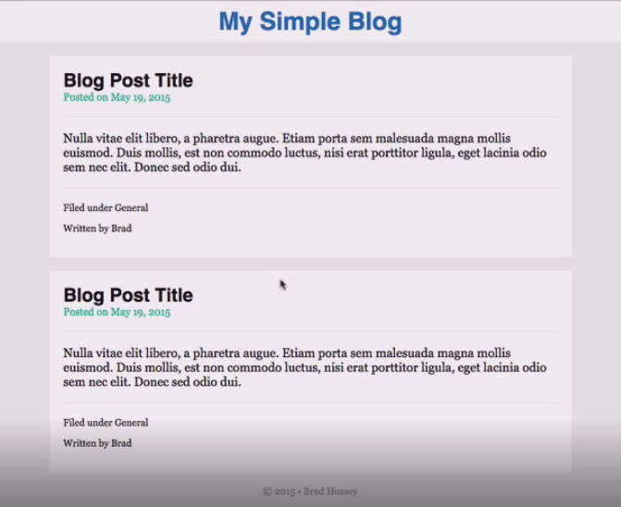
CSS Project

